Slide 1

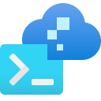
Demystifying Azure Developer CLI - a Swiss Army Knife for devs?
Kalle Marjokorpi 13.9.2023
Kalle Marjokorpi 13.9.2023

Slide 2


Kalle Marjokorpi
.NET developer since 2002
10+ years experience of Azure
Focused on web development in Microsoft stack/technology
Consultant 12+ years, previously Innofactor
In-house software development 3+ years
Lead Architect at If Insurance
Blogging - kallemarjokorpi.fi

Slide 3

Overview
Yet another CLI - What is the Azure Developer CLI? (10min)
DEMO: AZDify your existing project (20min)
  Sample application landscape
  Needed application configuration changes
  Typical AZD commands
  (CI/CD Pipeline)
  (Event Hooks)
Key takeaways
Questions

Slide 4

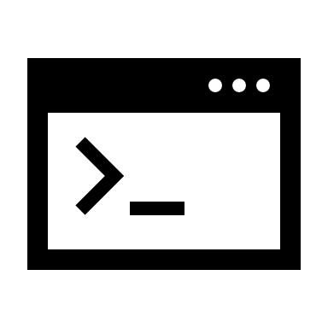





Azure Developer CLI focuses on the developer workflow
Provides capabilities to build apps faster, easier, more secure, and smarter to Azure Cloud
  Single tool that helps in multiple steps in developer workflow (from idea to cloud)
  Scaffold elements of IaC and pipeline artifacts. Simplify deployment pipelines.
  Fast delivery from the local environment to the cloud
  Reusability (templating)
  Open source, MS, and community-driven
  Easy to use and learn
Faster way to build apps to Azure Cloud
azd focuses on the developer workflow. Apart from provisioning/managing Azure resources, azd helps to stitch cloud components, local development configuration, and pipeline automation together into a complete solution.

Slide 5

AZ CLI vs. AZD CLI
They look similar but have a different focus.
Azure CLI (aka. AZ CLI)
Comprehensive support for managing Azure infrastructure and resources
Azure Developer CLI (aka. AZD CLI)
Focus on making infra provision and application deployment more straightforward
No capabilities to manage Azure resources
Automation capabilities for IaC and CI/CD

Slide 6
AZD in Developer workflow
Infrastructure as Code
Application deployment
Configuration Management
azd up
azd deploy
azd provision
Explore
Evaluate
Source Code
Version Control
azd template
CODE
DEPLOY
PLAN
RELEASE
Development
Automation
BUILD
DEV
OPS
OPERATE
azd init
azd env
RELEASE
PLAN
azd pipeline
azd up
az down
azd deploy
azd provision
TEST
MONITOR
azd monitor
Quality
Continuous Integration/ Continuous Delivery or Deployment (CI/CD)
Dashboards
Logging
Notes:
Azure Developer CLI reference | Microsoft Learn
azd auth: Authenticate with Azure.
azd config: Manage azd configurations (ex: default Azure subscription, location).
azd deploy: Deploy the application's code to Azure.
azd down: Delete Azure resources for an application.
azd env: Manage environments.
azd init: Initialize a new application.
azd monitor: Monitor a deployed application. (Beta)
azd package: Packages the application's code to be deployed to Azure. (Beta)
azd pipeline: Manage and configure your deployment pipelines. (Beta)
azd provision: Provision the Azure resources for an application.
azd restore: Restores the application's dependencies. (Beta)
azd template: Find and view template details. (Beta)
azd up: Provision Azure resources, and deploy your project with a single command.
azd version: Print the version number of Azure Developer CLI.

Slide 7


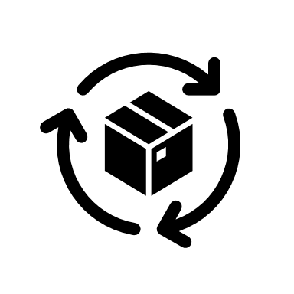



Combination of different tooling
CLI capabilities
Scaffolding logic
AZD CLI
GitHub CLI
Bicep CLI
+
=
Azure CLI
Terraform CLI
.NET CLI
How to deploy an Application and Infra to Azure?
Dotnet CLI + Bicep CLI + Azure CLI
AZD CLI
az bicep generate-params –file
az login
az account set
az deployment sub create
dotnet publish
az webapp deployment source config-zip
azd init
azd auth login
azd up
SAMPLE
SAMPLE

Slide 8



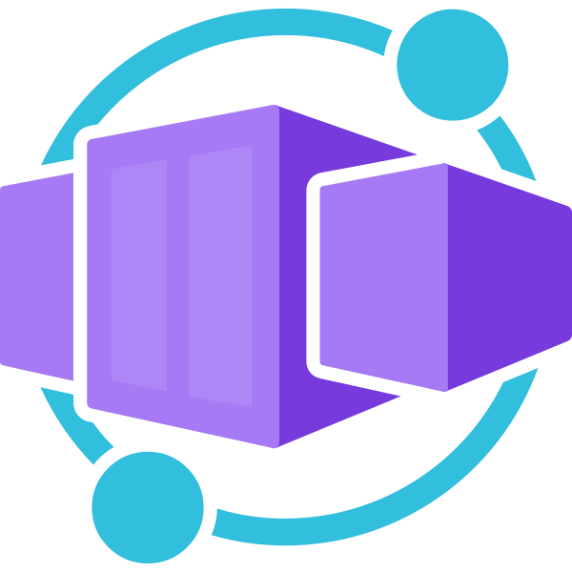
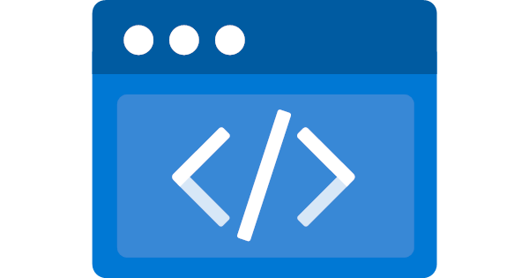

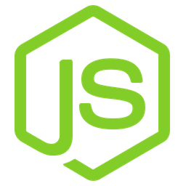











Tooling and support
Azure Cloud
App Service
Functions Apps
Kubernetes Service (beta)
Container Apps (beta)
Static Web Apps
Spring Apps
Programming languages
IaC Providers
Continuous delivery
Nodejs
Python
Bicep
GitHub Actions (YAML)
DotNet
Java
Terraform
Azure Pipelines (YAML)
Development Environment
Local
GitHub Codespaces
Dev Containers

Slide 9

DEMO: AZDify your existing project

Slide 10

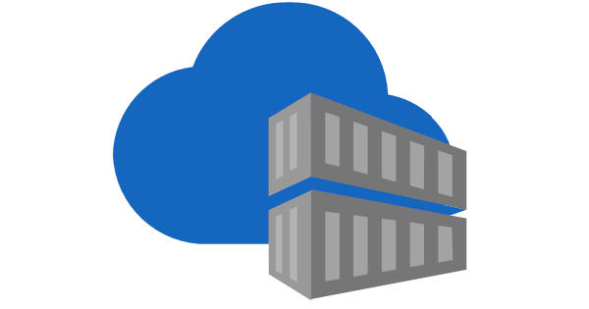





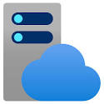
Sample application landscape
Application topology
Infrastructure as a Code - Reusable Bicep modules in Azure Container Registry
Deployment pipelines - Reusable YAML templates in Azure Repository
Logging
App Insights
Log Analytics
Monitoring
API Application
Dashboard
App Service
App Service Plan

Slide 11



Demo summary
3. Provision infra
azd provision
1. Initialize the project
2. PREPARE
3. Deploy app to Azure
azd init
azd env
Environment variables
AZD Metadata file (azure.yaml)
ADO/Github Actions pipeline
Configure Hooks
azd deploy
3. DEPLOY INFRA AND APP
azd up
(azd down)
Notes:
Infra provision is always incremental

Slide 12


Key takeaways
A single tool focused on boosting developer workflow
Powerful templating/blueprinting capabilities
Streamlined workflow – from local environment to cloud in minutes
Can simplify CI/CD pipelines
Learn YAML and IaC (Bicep/Terraform)
Testing and proof-of-concepting
Templating and blueprinting in enterprise environment
Discover and get ideas: Awesome AZD Templates
  Over 50 templates available

Slide 13

Questions

Slide 14
Thank you!
https://www.theurlist.com/azure-friends-130923

